Slide 1
How to create an array from existing array ?
momedaram

Slide 2
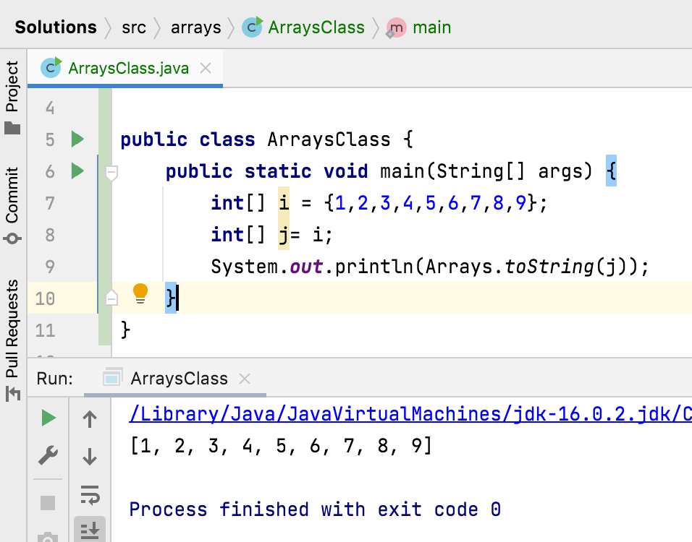
How to create an array from existing array ?

Slide 3
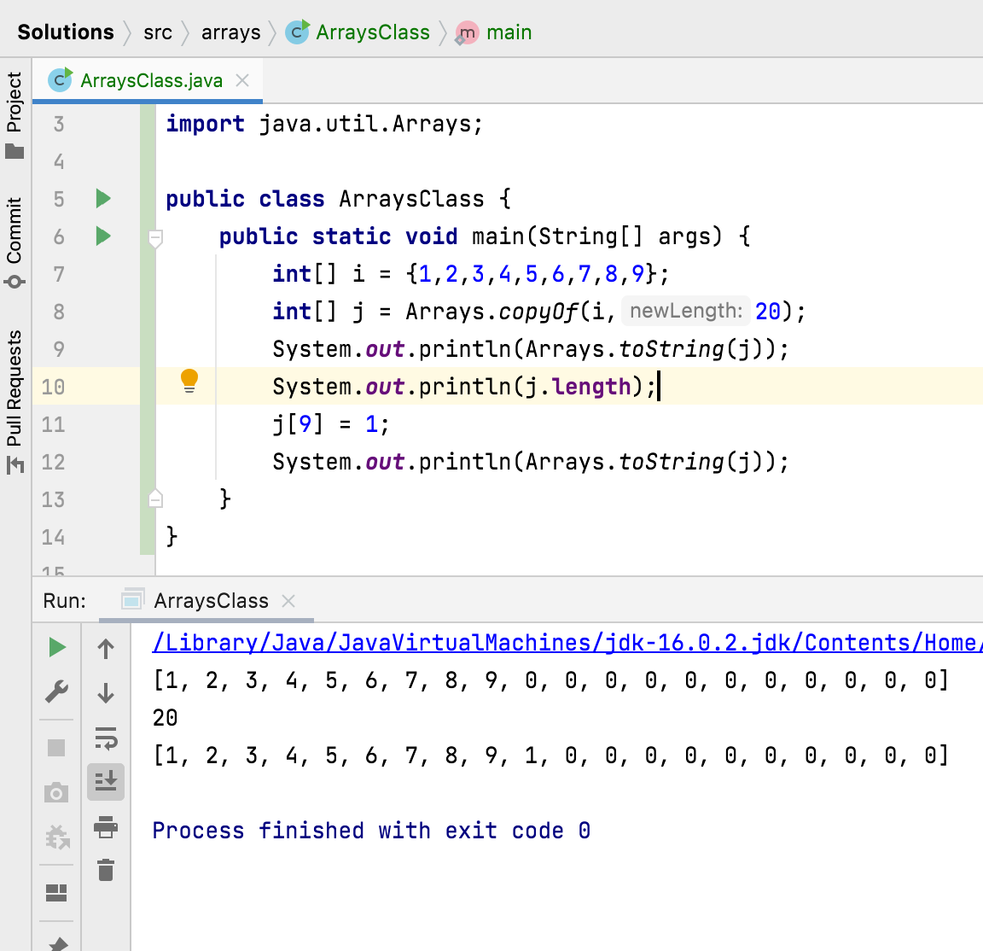
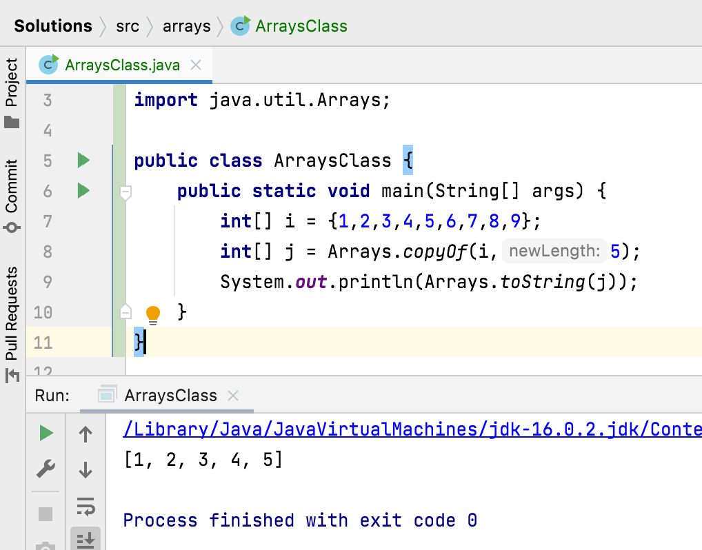

Slide 4
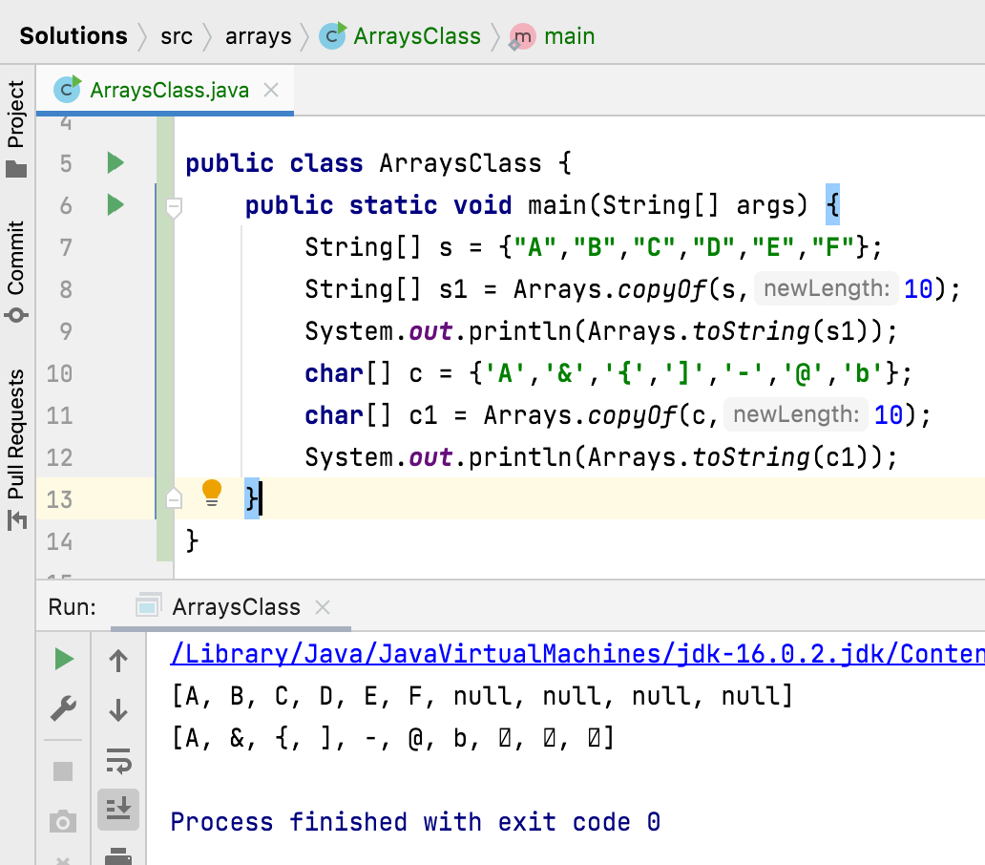
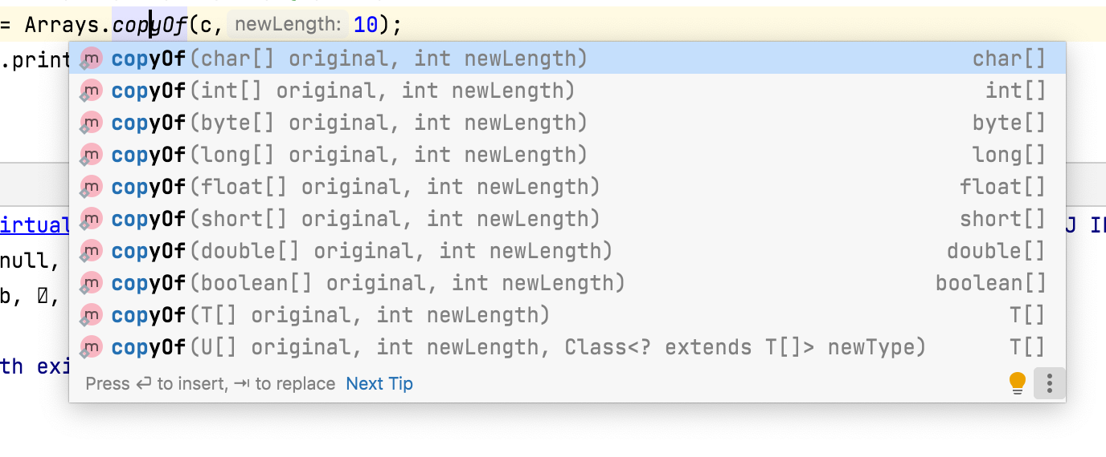

Slide 5
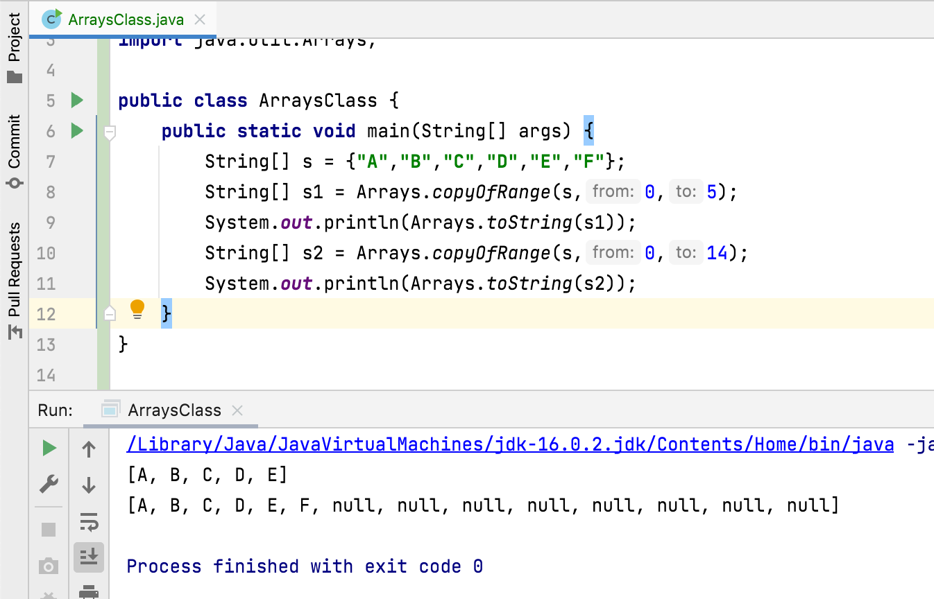

Slide 6
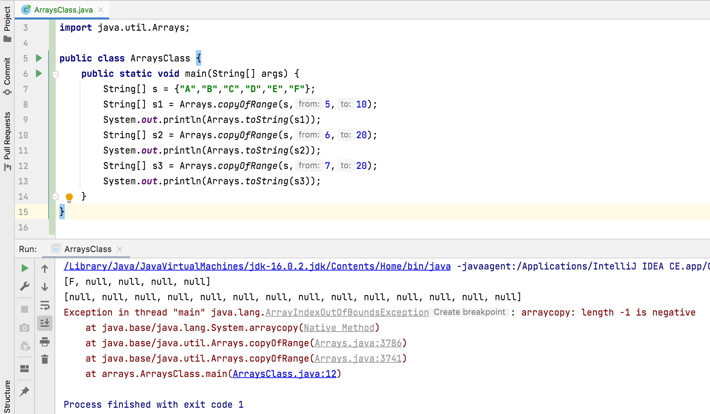

Slide 7
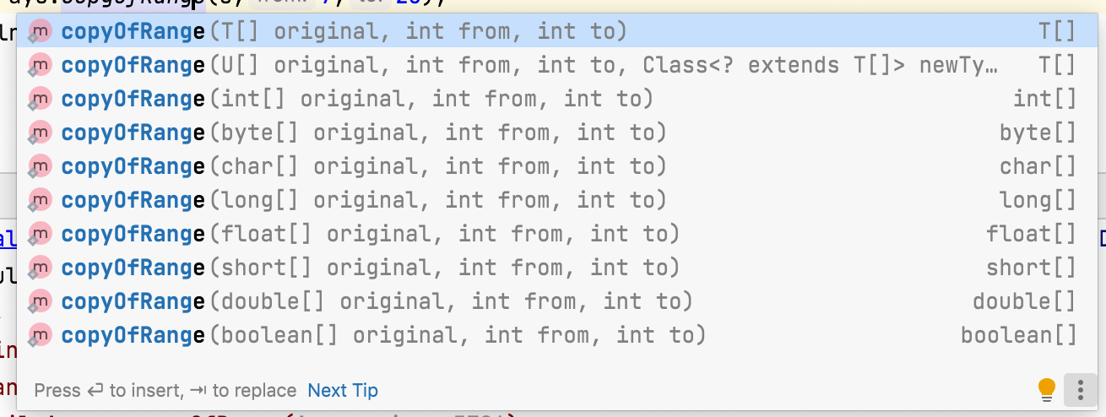

Slide 8
How to create an array from existing array ?
Arrays.copyOf(original [] , newLength) - Copies the specified array into new array of same type. While copying, the new array may be truncated or padded with default values so that it has the specified length.
May Throws:
NegativeArraySizeException – if newLength is negative
NullPointerException – if original is null
Arrays.copyOfRange(original [], from , to) - copies some part of the specified array into new array of same type. While copying the new array may be truncated or padded with default values so that it has the specified length.
May Throws:
ArrayIndexOutOfBoundsException – if from < 0 or from > original.length
IllegalArgumentException – if from > to
NullPointerException – if original is null

Slide 9
Thank You !
momedaram

